Slide 1
Hi

Slide 2
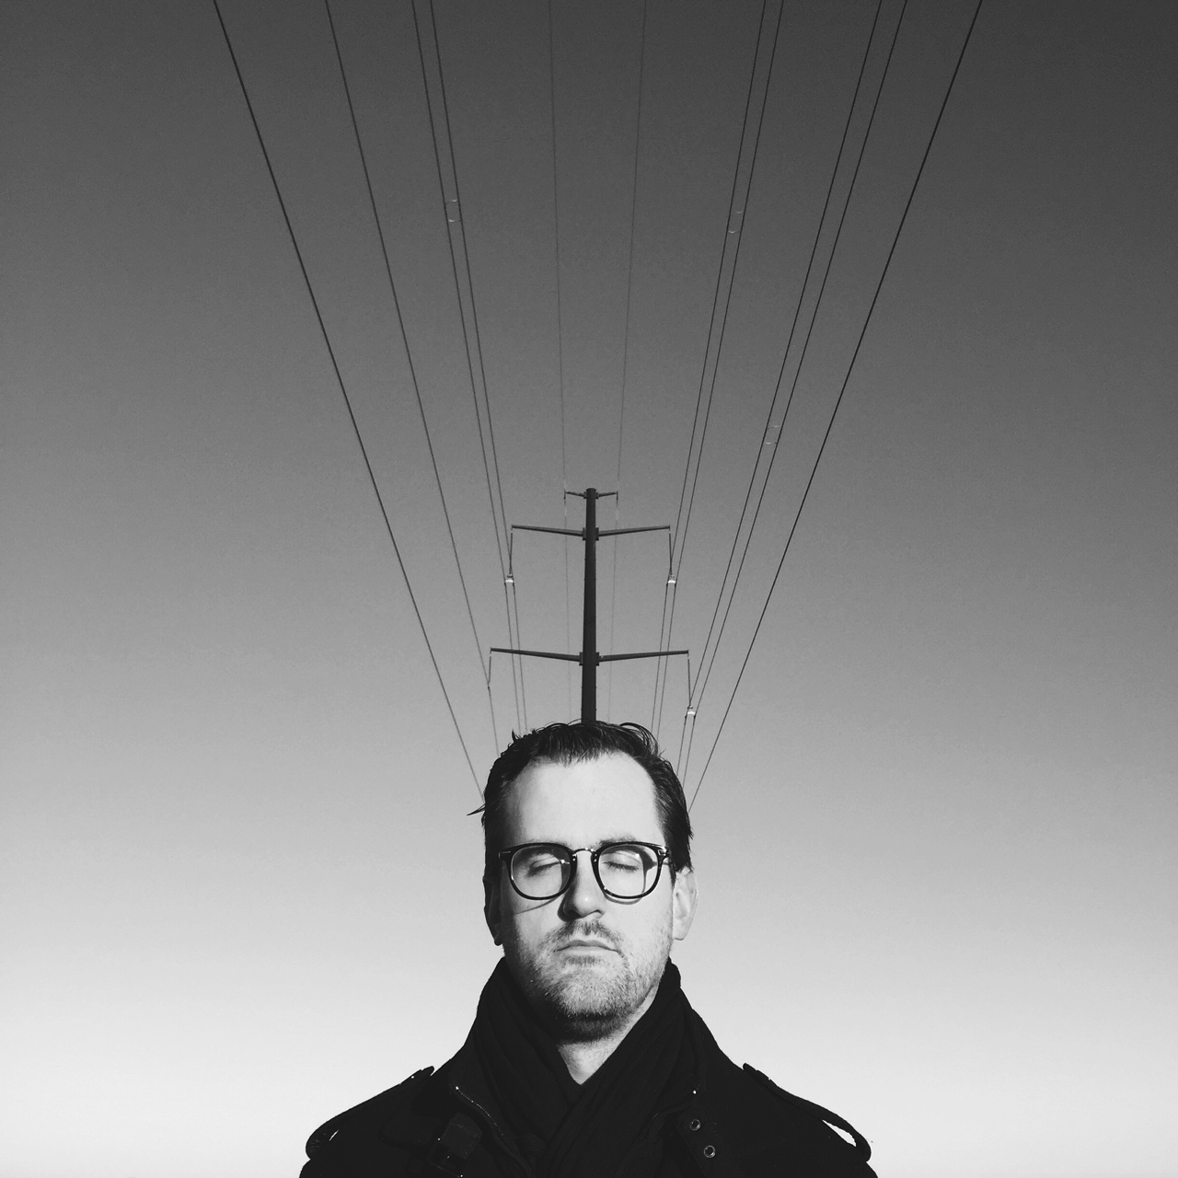
I’m Matt.

Slide 3
It’s brag time

Slide 4

Brand
New
Box

Slide 5

It’s a box.

Slide 6
It’s a box.

Slide 7
We’re a digital product studio.

Slide 8
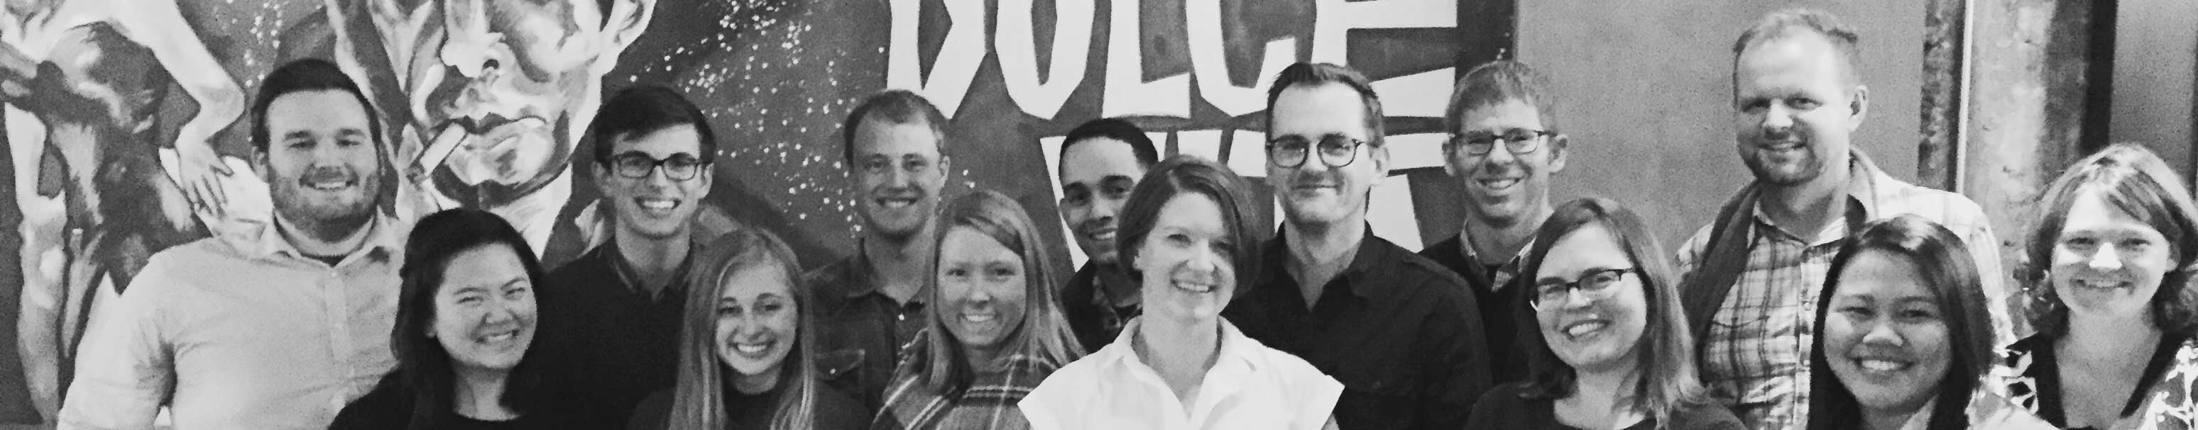
We’re
small.

Slide 9
We make big software.

Slide 10
Like this:

Slide 11
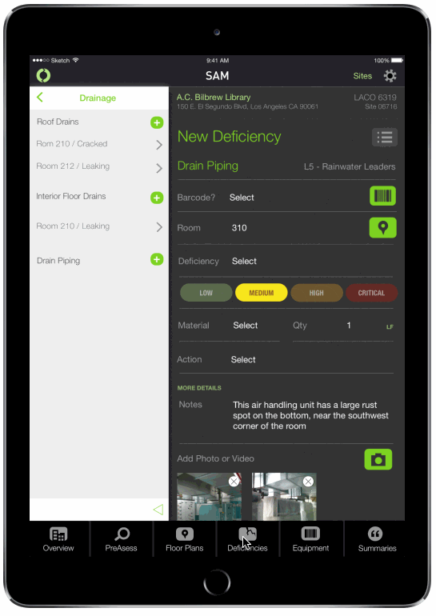

Slide 12
and this:

Slide 13
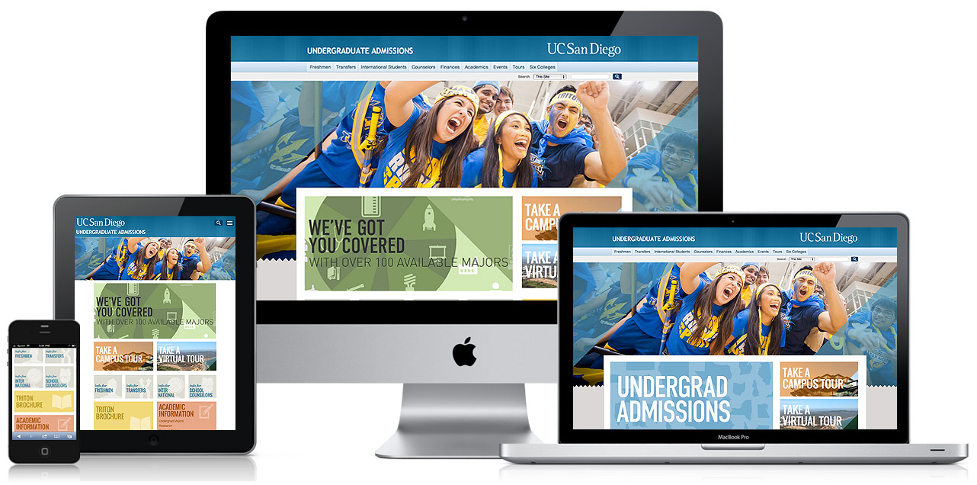

Slide 14
and

Slide 15

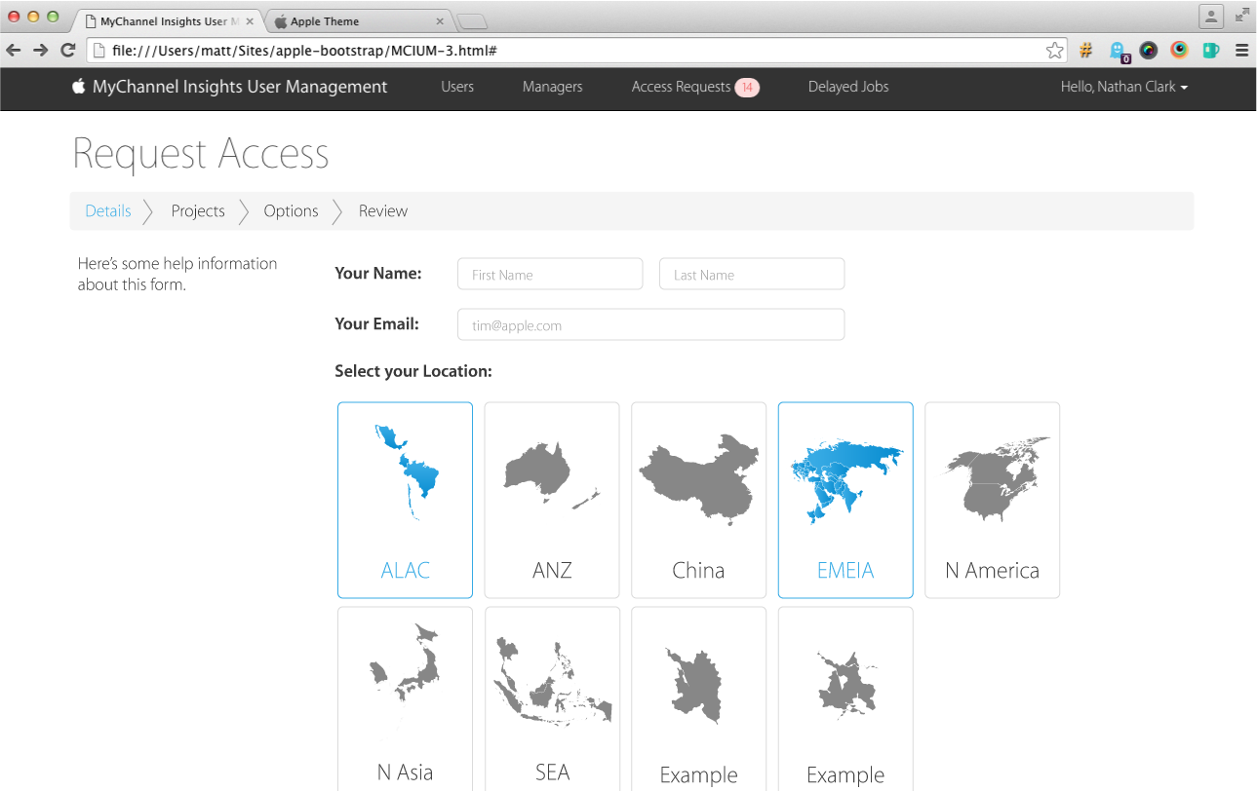

Slide 16
and

Slide 17
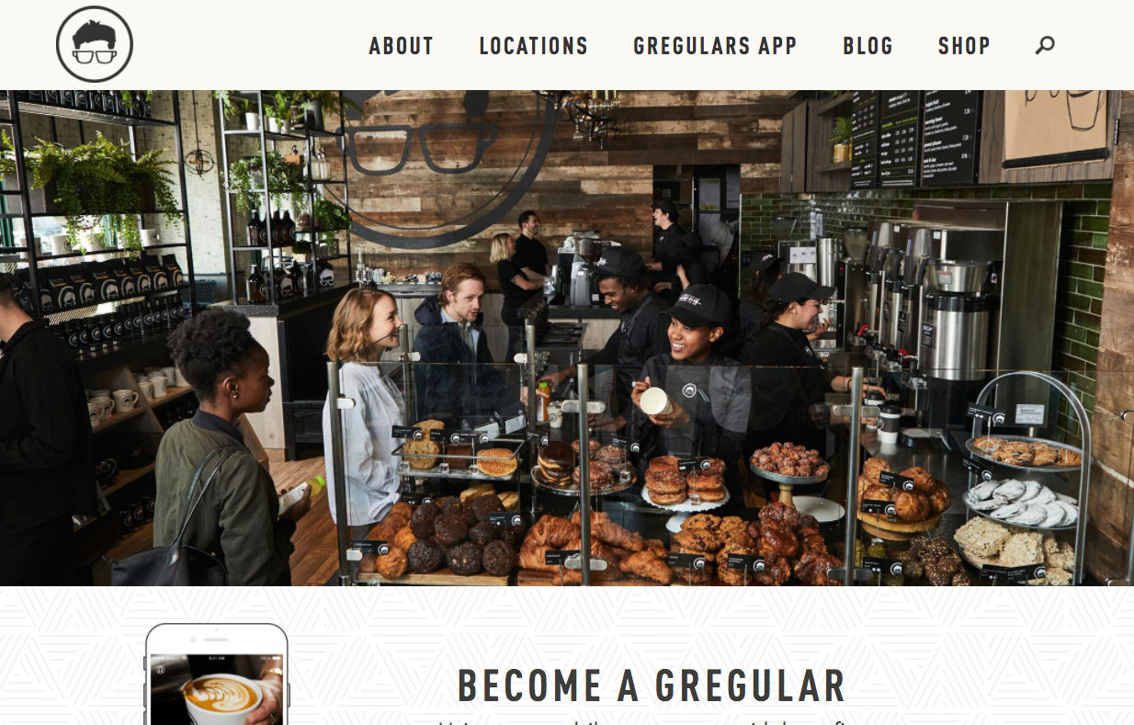
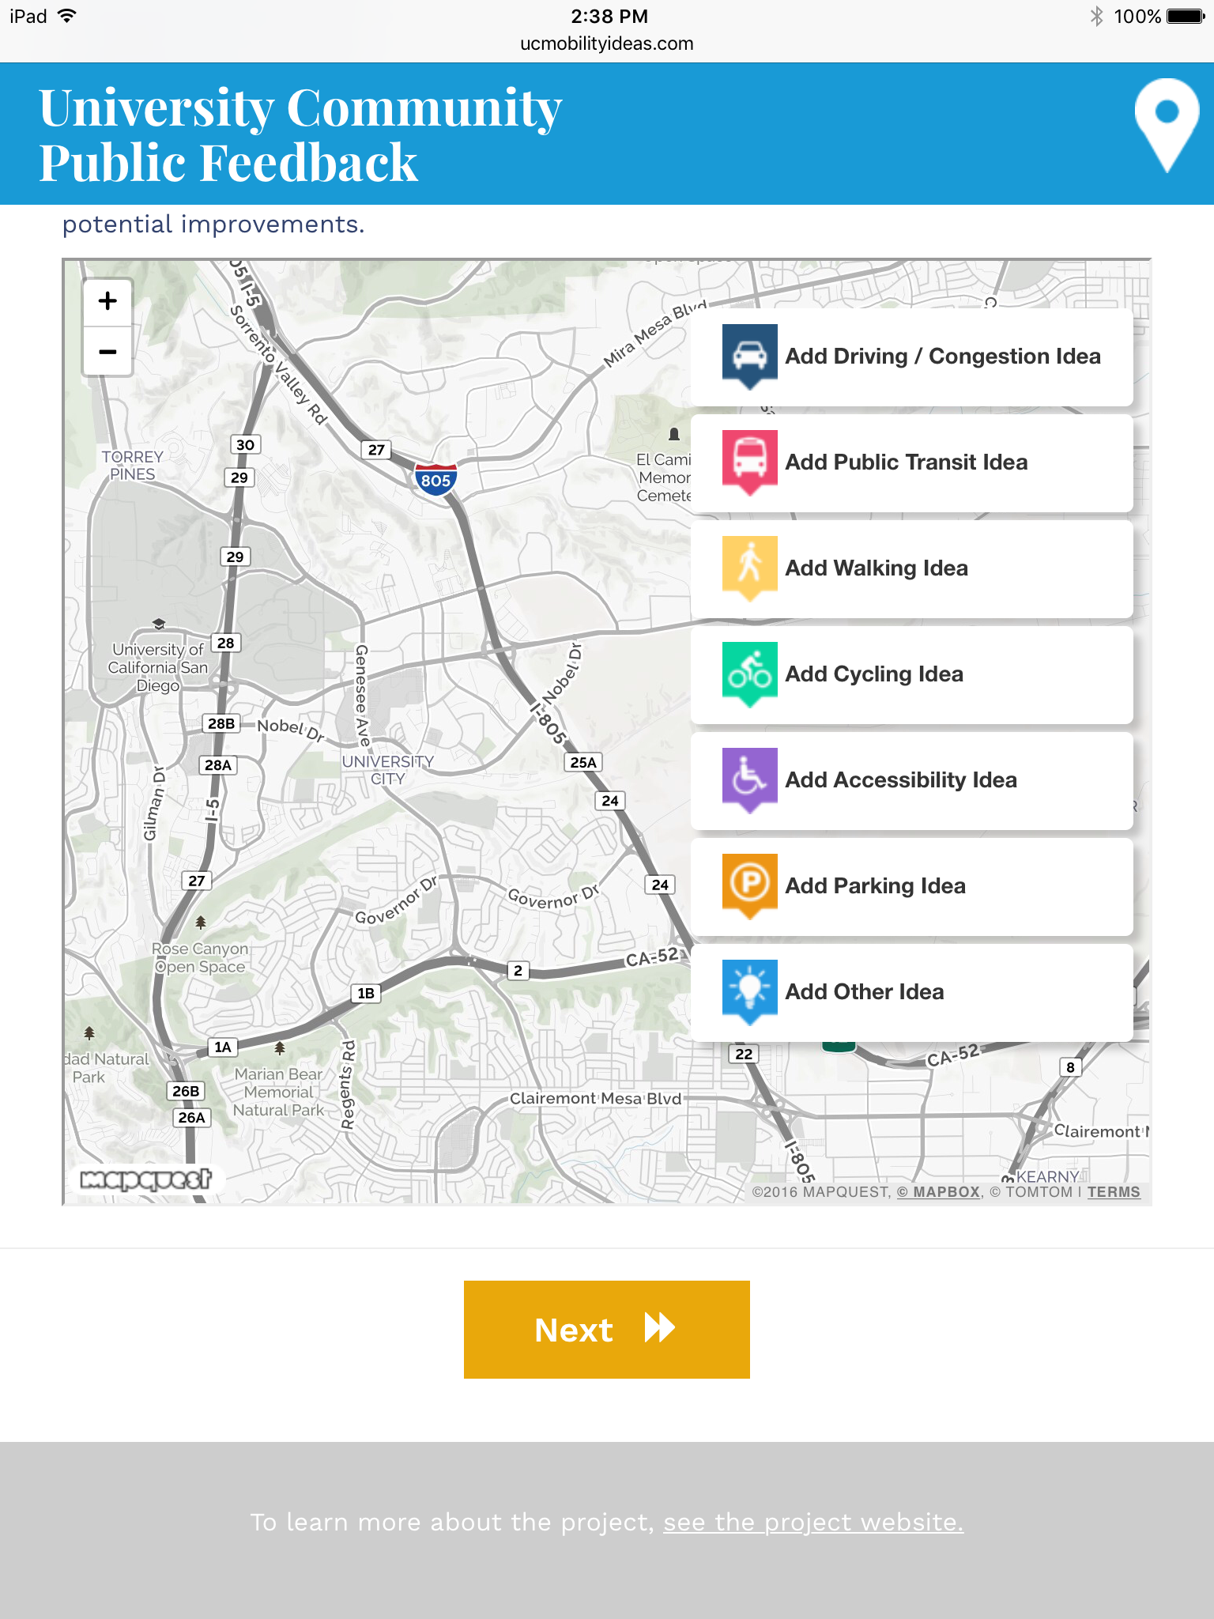

Slide 18
and

Slide 19
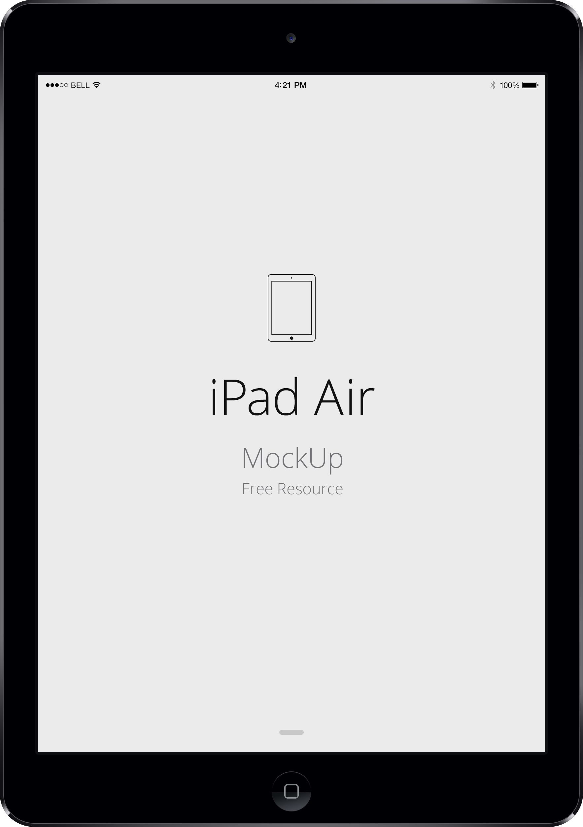

Slide 20
and

Slide 21
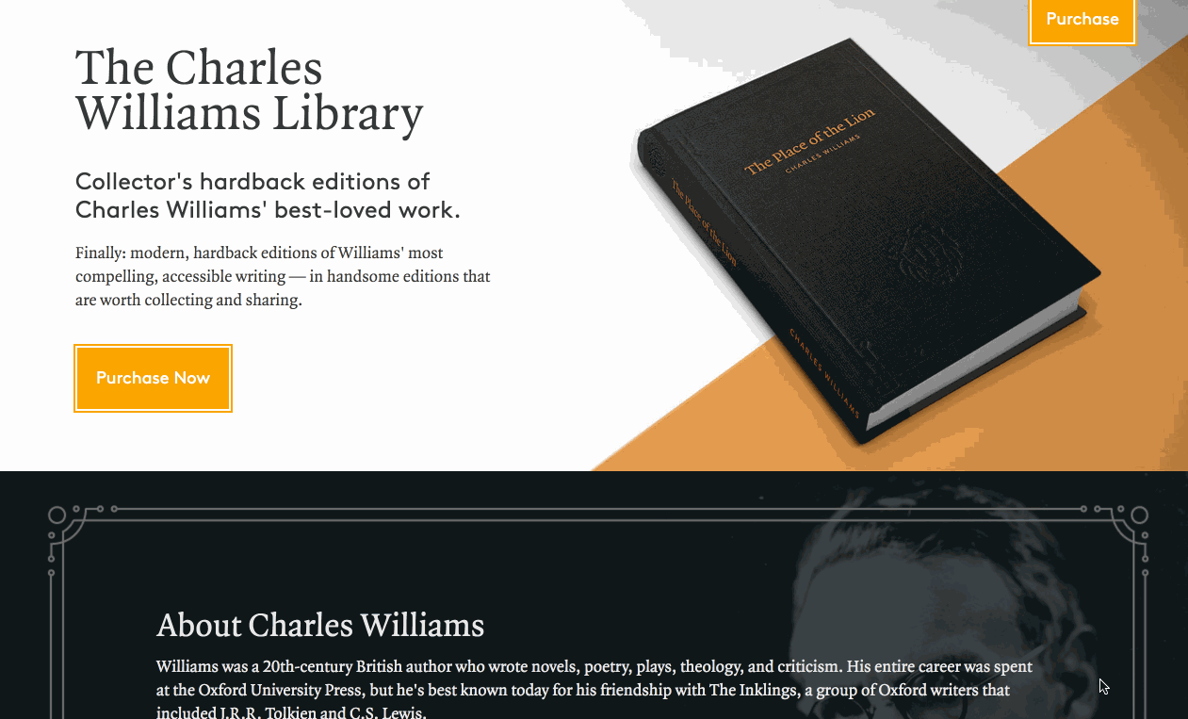

Slide 22
We use
strategy,
design, & development.

Slide 23
We work
with clients.

Slide 24
Apple
PayPal
McAfee
IBM
US Army
US Navy
US Air Force
US Marines
Federal Highway Administration
County of Los Angeles
California State Parks
City of Peterborough, UK
Doña Ana County, New Mexico
AECOM
First Allied Securities
University of California, San Diego
University of Kansas
Developmental Studies Center
San Diego Center for Algae Biotechnology
UCSD Sustainability Center
Salk Institute
Maasai Wilderness Conservation Trust
International Arts Movement
The Charles Williams Society
Atlas Spiritual Design
Center for Church Communication
World Youth Day
BMW
Everlast
Toyota Racing
Saab
UC San Diego
Toshiba
MINI

Slide 25
So.

Slide 26
Photoshoot time

Slide 27
Experience

Slide 28
Syllabus

Slide 29
Big ideas

Slide 30
User- centered

Slide 31
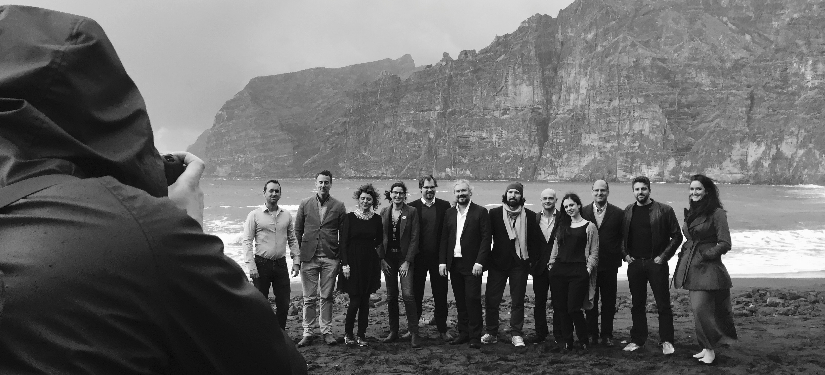





Slide 32
Process- Oriented
tt

Slide 33
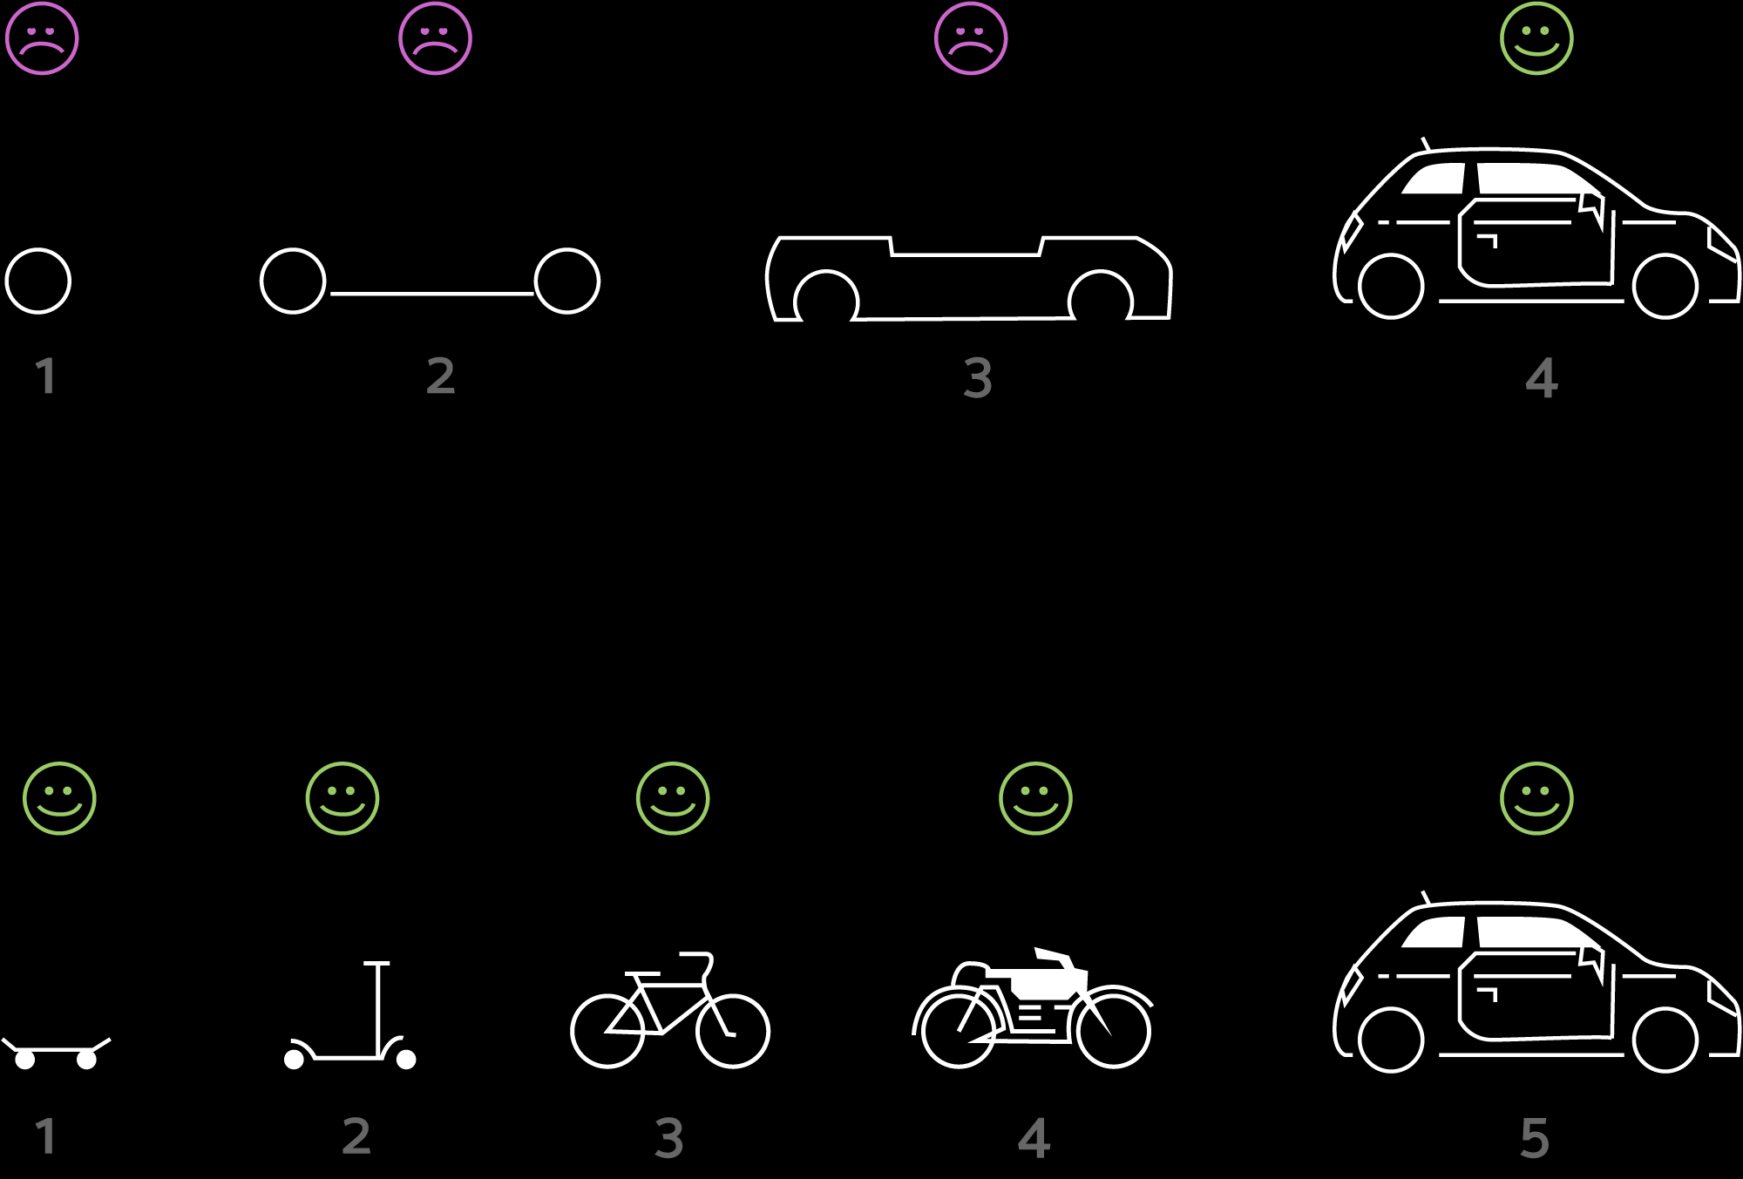

Slide 34
Words as Material

Slide 35
User Experience Model
tt

Slide 36
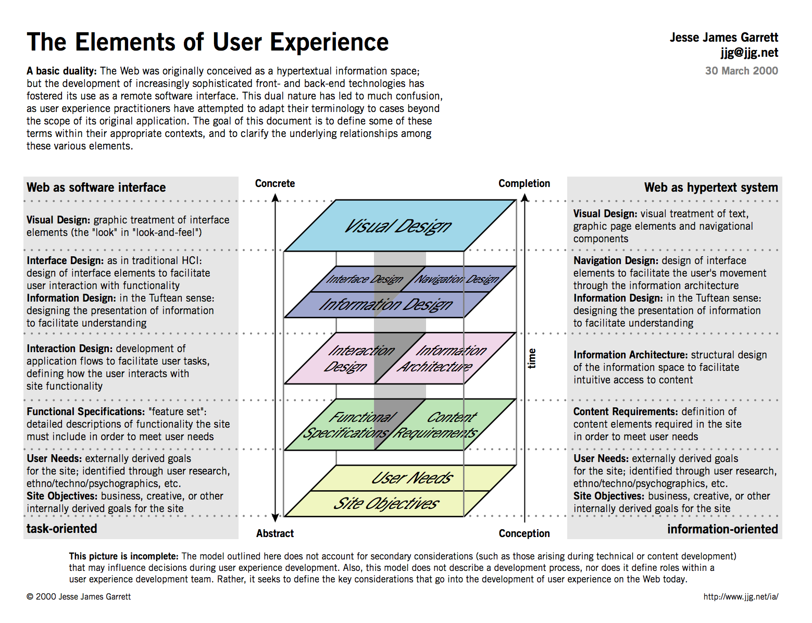

Slide 37
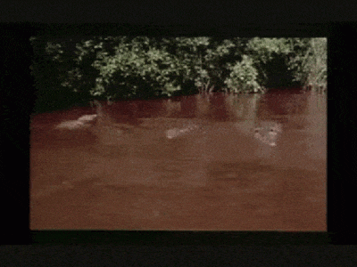

Slide 38
Stock & Flow

Slide 39
Hustle

Slide 40
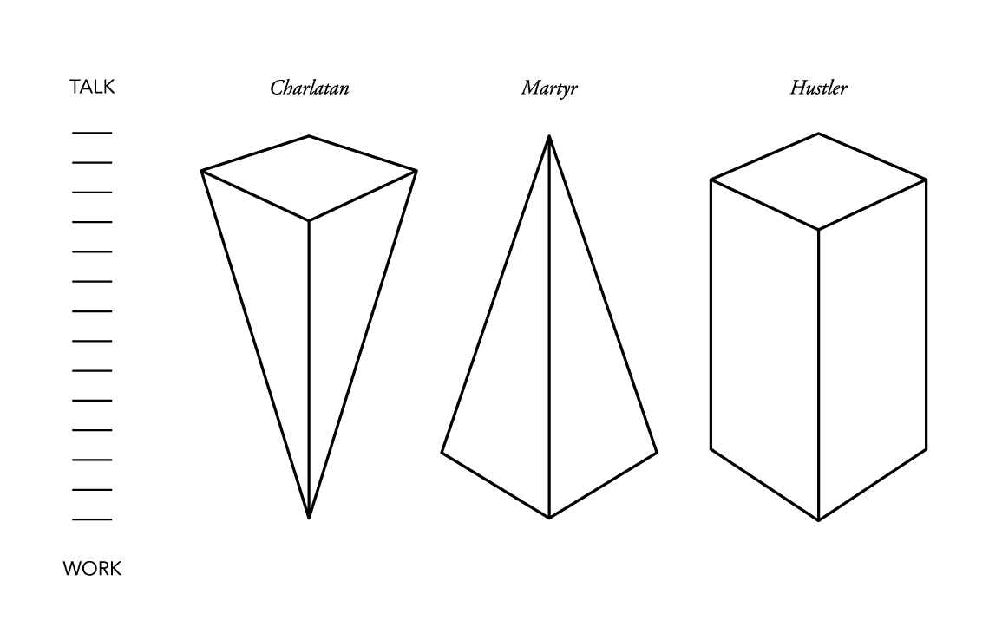

Slide 41
C students

Slide 42
Getting started

Slide 43
Sketchbook

Slide 44
Slack

Slide 45
Domain name

Slide 46
Hosting

Slide 47
Text Editor

Slide 48
FTP client

Slide 49
Sketch

Slide 50
Get Coding! Book

Slide 51
And that’s it

Slide 52
For Monday:

Slide 53
Domain Hosting FTP Client Text Editor ‘Get Coding!’ Book Watch ‘When We Build’ Niche Ideas!

